Slide 1
Economics I
Week #8

Slide 2
Topics of Week #8
Long-Run Costs
Defining Monopoly
Characteristics of Monopolies
Profit Maximizing Rule for Monopoly*
Contrasting Competition and Monopoly*
Problems with Monopoly*
Deadweight loss (DWL) of Monopoly*
Solutions to Monopoly*
Government Failure
"*" Indicates the most important topics.
Mateer and Coppock: Chapter #8 and #10

Slide 3
Long-Run Costs
Scale
Size of the production process
Efficient scale
The level of output in which ATC is minimized
Note that the MC curve passes through the minimum of the ATC curve.
Notes:
A long run time horizon allows a business to choose a scale of operation that best suits its needs. For instance, if a local McDonald's is extremely popular, in the short run the manager can hire more workers or expand its hours to accommodate more customers. However, in the long run, all costs are variable; the manager can add drive-through lanes, increase the number of registers, expand the grill area, and so on.

Slide 4
Long-Run Costs
Economies of scale
ATC falls when production expands.
Larger firm is more efficient than a smaller firm.
Diseconomies of scale
ATC rises when production expands.
Very large firm has to deal with additional management, coordination, logistics expenses.
Constant returns to scale
ATC doesn't change when production expands.
Olive Garden builds another restaurant. Requires same K and L as previous restaurants. Output is similar.
Notes:
Economies of scale
Water companies provide a good example of economies of scale. Your local water company must treat and purify the water that it delivers. This is a high- volume business. Imagine what would happen if there were many water suppliers. Each company would need its own treatment plant and delivery infrastructure. But building a system of water pipes is expensive and time consuming. It is cheaper to have one larger company provide water for everyone in a local community.
Diseconomies of scale
As the scale of an enterprise grows larger, it might require more managers, highly specialized workers, and a coordination process to pull everything together. As the layers of management expand, the coordination process can break down. Financial institutions that do most of their business online have lower management costs and also benefit from not having to build expensive offices. The lower administrative costs of these smaller online banks make it possible for them to offer higher interest rates on savings accounts than traditional “brick and mortar” banks, which suffer from high management costs.
Constant returns to scale
Olive Garden competes with local Italian restaurants. In each case, the local costs to hire workers and build the restaurant are the same. Olive Garden does have a few advantages; for example, it can afford to advertise on national television, and buy food in bulk. But Olive Garden also has more overhead costs for its many layers of management. Constant returns to scale in the bigger chain means that a small local Italian restaurant will have approximately the same menu costs as its bigger rivals.

Slide 5
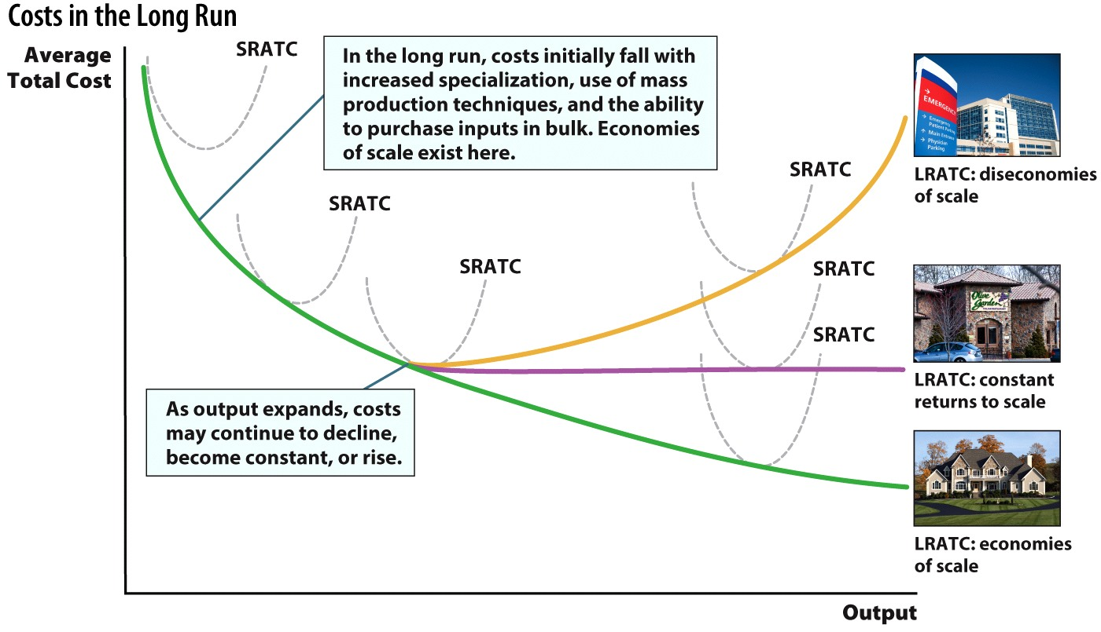
Costs in the Long-Run
Notes:
In the long run there are three distinct possibilities: economies of scale, constant returns to scale, and diseconomies of scale.
At first, each long run average total cost curve (LRATC) exhibits economies of scale as a result of increased specialization, the utilization of mass production techniques, bulk purchasing power, and increased automation. The real question in the long run is whether the cost curve will continue to decline, level off, or rise.
In an industry with economies of scale at high output levels, for example a water company, the cost curve continues to decline and the most efficient output level is always the largest output—you can see this by looking at the dashed red line in the figure. In this situation we would expect that only one large firm will come to dominate the industry because larger firms have significant cost advantages.
However, in an industry with constant returns to scale, for example restaurants, the cost curve flattens out—you can see this by looking at the black dashed line. Once the curve becomes constant, firms of varying sizes can compete equally with one another because they have the same costs.
In the case of diseconomies of scale, for example traditional banks, bigger firms have higher costs—you can see this by looking at the blue dashed line.

Slide 6
SR and LR Cost Comparison
The short-run cost curve and the long-run cost curve are both U-shaped. However, they are U-shaped for different reasons!
SRATC
U-shaped because of diminishing marginal product
MP_{L} falls, MC rises, and ATC follows MC.
LRATC
U-shaped because of economies and diseconomies of scale
Smaller firms can lower costs by growing, but if they get too big, costs can grow.

Slide 7
Previously
Profits and losses act as signals in a perfectly competitive market.
For perfect competition to exist, two factors must be in place:
A perfectly competitive market
Easy entry and exit from the market
A price taker has no control over the price it pays, or receives, in the market.
A firm that maximizes profits will expand output (Q) until MR = MC = P

Slide 8
Defining Monopoly
Monopoly
Single seller who sells a product without close substitutes
It can prevent entry for new firms.
Ability to set the price of a good or service
How do monopolies persist?
Recall what happens in perfectly competitive markets with free entry.
Barriers to entry
Restrictions that make it difficult for new firms to enter a market
Allows many monopolists to enjoy long run economic profit.
Notes:
Note that the good produced by the monopoly has no good substitutes.
In perfect competition, other firms entered the market during profitable times and high prices. Why don't other firms join the monopoly's industry and compete with it and take some of its profits? The answer is because of entry barriers.
Entry barriers keep other potential competitors out of the market. As long as there are entry barriers, a monopolist can enjoy long run profits. However, just because a firm is a monopoly doesn't guarantee profits. If demand for the monopoly product is low, it may shut down or go out of business in the long run. The trucking industry put an end to the railroad monopoly. (Increase in trucking and the interstate decreased demand for rail use).

Slide 9
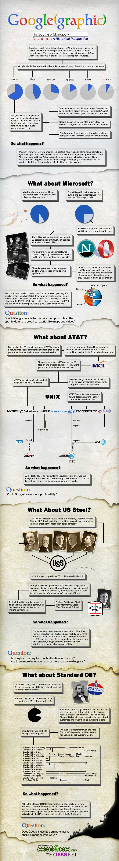
Is Google a Monopoly? Is Microsoft a Monopoly?
Notes:
Real-world example: Is Google a Monopoly? (See Tip #365)
The infographic shown on the slide shows monopolies throughout U.S. history.
Infographic Source: http://www.scores.org/graphics/monopoly/

Slide 10
Is AT&T a Monopoly? Is US Steel a Monopoly?
Notes:
Real-world example: Is Google a Monopoly? (See Tip #365)
The infographic shown on the slide shows monopolies throughout U.S. history.
Infographic Source: http://www.scores.org/graphics/monopoly/

Slide 11
Is Standard Oil a Monopoly?
Notes:
Real-world example: Is Google a Monopoly? (See Tip #365)
The infographic shown on the slide shows monopolies throughout U.S. history.
Infographic Source: http://www.scores.org/graphics/monopoly/

Slide 12
Economics in Forrest Gump
"Forrest Gump"
Forrest Gump goes into the shrimping business.
Notes:
"Economics in the Media" Slide
Lecture tip:
The clip mentioned on the slide can be found in the Interactive Instructor's Guide. Access the direct link by clicking the icon in the PowerPoint above.
The key concepts covered in this clip are:
Sources of monopoly
Competition
Supply and demand

Slide 13
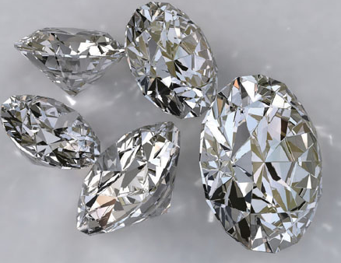
Natural Barriers to Entry
Natural Barriers to Entry
Control of resources
If a monopoly controls all of a resource (input) necessary for production, competitors cannot enter
ALCOA, De Beers
Inability of potential competitors to raise enough capital
Monopolies are often very established after years of growing. Can you raise $10 million of capital to compete?
Notes:
Control of resources:
In the early 1900s, ALCOA (Aluminum Company of America) owned 90% of the world's bauxite, the essential input in making aluminum. ALCOA just simply purchased all the bauxite mines around the world.
De Beers diamonds did the same thing (around the same time period as well). In the early 1900s, De Beers owned over 90% of the world's diamond supply. They just simply bought every diamond mine.
Raising capital:
Difficult to compete with an established monopoly that already has a huge amount of capital and equipment. A lender may not want to loan you $10 million to try and start a business. That's a big loan!

Slide 14

Natural Barriers to Entry
Economies of scale
"Bigger is better" (more cost-efficient)
This is due to the ATC being downward-sloping over a large range of output.
Lower costs → lower prices
Car production, electricity production, mail delivery
Natural monopoly
A monopoly exists because a single large firm has lower costs than any potential competitor.
In addition, breaking up the firm into multiple competitors may increase costs as well.
Notes:
Economies of scale
Recall this definition from Chapter 8. Average costs fall as output increases. Which do you think can be done at an OVERALL lower cost? One hundred car producers making 10 cars each or two car producers making 500 cars each? A total of 1,000 cars is made in each case, but due to the nature of the cost structure of car production which exhibits economies of scale, average costs fall with output increases and two firms producing more cars will have overall lower costs.
Natural monopoly
It's just “natural” to have a monopoly since it provides the lowest (most efficient) costs. Realize however, that a monopoly (natural or not) will enjoy significant market power and may not pass cost savings to consumers in the form of lower prices. Natural monopolies (such as electric companies) are often regulated by the government to prevent abuse of market power.

Slide 15
Government Created Barriers
Licenses, qualifications
License to use certain radio or TV frequency (prevent the negative externality of interference)
Must be qualified to practice medicine or law
Patents and copyright law
Patent
Temporarily grants monopoly rights to a product
An incentive to innovate
However, copyrights (and higher resulting prices) sometimes create unintended consequences.
File sharing, movie pirating
Notes:
Licenses Often, you cannot broadcast unless you have a government-sponsored operating license. However, in certain places, corruption and bribery determine who gets the limited licenses.
Not everyone can do brain surgery or judge a court case. We want to reserve these important duties for only qualified individuals with a medical license or JD.
Patents
Patents and copyrights create stronger incentives to find new drugs and make new music than would exist if market forces could immediately copy inventions. The result is that pharmaceutical companies invest heavily in researching and developing new drugs and musicians devote their time to writing new music.
However, many economists wonder if patents and copyrights are necessary or have unintended consequence of their own. Justin Bieber was able to use his Internet fame to launch his career without his music being tightly controlled by music studio copyrights.
For file sharing and music/movie pirating, see how many of your students are in favor of the MPAA or RIAA.

Slide 16
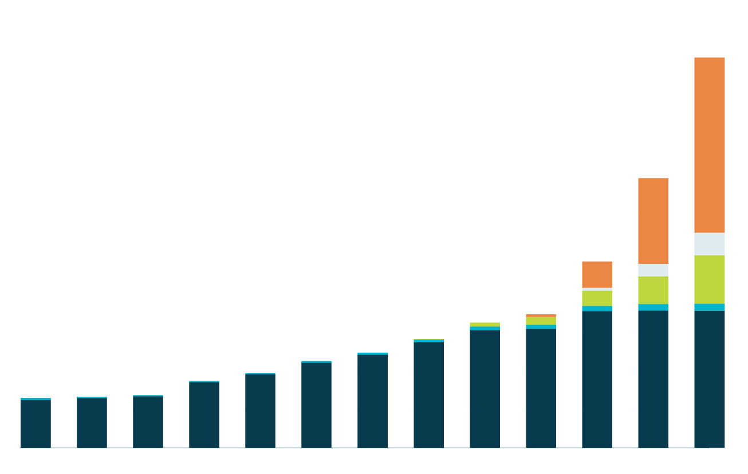


The Demise of a Monopoly
SNAPSHOT
1,100
1,000
PC
Since 2007, the explosive growth of smartphone and tablet sales has tilted the operating system market toward Android (owned by Google) and Apple, eating into Microsoft's market share.
iMac
900
iPhone
800
Android Devices
iPad
700
600
In the early 2000s, Microsoft controlled nearly 100% of the operating system market (through PC sales), but Apple sold enough of its Mac computers to remain in business.
Unit Sales (millions)
500
400
300
200
100
2000
2001
2002
2003
2004
2005
2006
2007
2008
2009
2010
2011
2012
Notes:
A monopoly can be broken up by the courts or by market forces. In the case of Microsoft, only one has worked. In November 1999, a federal judge declared Microsoft a monopoly of computer operating systems. The original decision underwent appeals that continue to this day, making the ruling largely ineffective in breaking up the monopoly. But market forces have had more success. New technologies have made the market much more competitive, meaning Microsoft is rarely considered a monopoly anymore.
REVIEW QUESTIONS
About what percentage of the operating system market did Microsoft (PC) control in 2012?
Describe the demise of the Microsoft operating system monopoly using the following terms: competitions, innovation, and market power.

Slide 17
The Monopolist's Pricing and Output Decisions
Perfectly competitive firms
Price takers cannot affect the price.
Each firm faces a horizontal demand.
Monopoly firm
Price maker sets the price by choosing output level.
Faces the downward-sloping demand curve for the entire industry
Notes:
If a firm faces a downward-sloping demand curve, it is indicative of the firm having at least some market power and the ability to set its price.
In PC (Perfect Competition), there are hundreds of firms selling substitute products. No one firm can determine the price. The price is determined by market supply and demand.
In monopoly, the one firm IS the market. Later, we will see that the monopoly does not have a supply curve. It simply chooses the output level where its MR = MC and charges a price based on the height of the demand curve at that level of output.

Slide 18
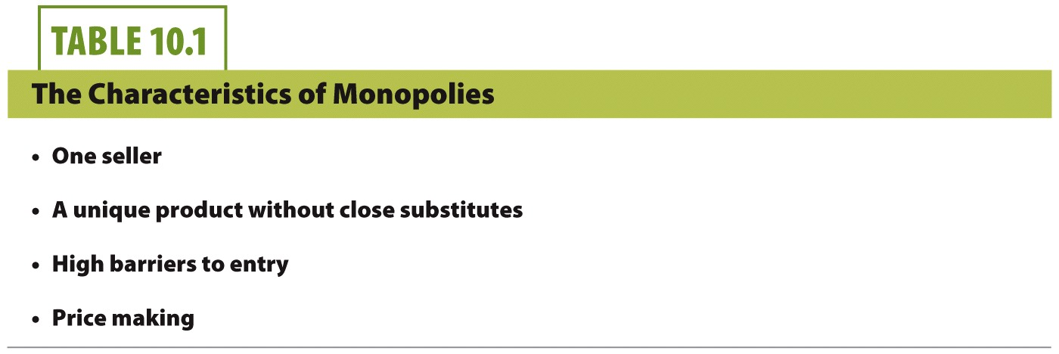

Slide 19
Comparing Demand Curves
Notes:
Perfectly competitive firms have a demand curve that is horizontal. Since the monopolist is the sole provider of the good or service the demand for its product depends on the price that is charged. This is reflected in a downward-sloping demand curve. So while the perfectly competitive firm has no control over the price it charges, the monopolist must search for the price and output combination that maximizes its profits.
The monopoly, while having market power, is still limited by what price it can charge. The demand curve shows the consumer willingness to pay for the product and guides the monopolist to what price it will charge.

Slide 20
Profit Maximizing Rule for Monopoly
Similarity between monopoly and perfectly competitive firms
Profit is maximized at output level (Q) where MR = MC
Difference between monopoly and perfectly competitive firms
In perfectly competition, P = MR = MC
In monopoly, P > MR = MC
To increase output, monopoly must lower the price. Perfectly competitive firms can sell as much as they want at the market price.
Notes:
For any firm, profit is maximized at the output level where MR = MC.
In competition, the demand curve (price) and the MR curve were the same horizontal line. In monopoly, the MR curve lies below the demand curve, so P > MR.
For monopoly, this results in P > MC. If price is greater than marginal cost, the firm has market power. The size of the difference between P and MC illustrates the amount of market power. A higher price markup from MC indicates higher market power.

Slide 21
Monopoly Marginal Revenue
Quantity (Q) | Price (P) | Total Revenue (TR) = Q × P | Marginal Revenue per 1,000 Quantity (MR) = ΔTR
0 | $100 | $0.00
1,000 | 90 | 90,000 | $90,000
2,000 | 80 | 160,000 | 70,000
3,000 | 70 | 210,000 | 50,000
4,000 | 60 | 240,000 | 30,000
5,000 | 50 | 250,000 | 10,000
6,000 | 40 | 240,000 | -10,000
7,000 | 30 | 210,000 | -30,000
8,000 | 20 | 160,000 | -50,000
9,000 | 10 | 90,000 | -70,000
10,000 | 0 | 0.00 | -90,000
Notes:
Notice the inverse relationship between output (quantity) and price since the monopolist faces a downward-sloping demand curve.
Total revenue is calculated by multiplying output by price, (TR = Q × P). At first total revenue rises as the price falls, then, once the price becomes too low ($40), it begins to fall. As a result, the total revenue function rises to $250,000 before it falls off.
The final column, marginal revenue (MR), shows the change in total revenue. Here we see positive (green text) (though falling) marginal revenue associated with prices above $50. Below $50, marginal revenue becomes negative.
Negative marginal revenue (red text) means that total revenue decreases if the monopoly were to continue selling more units. Realize that in order to sell more units, the monopolist must lower its price.

Slide 22
Monopoly Marginal Revenue
When the monopoly decreases its price in order to sell more output units, two things happen:
The price effect
All units are now sold at a lower price. By itself, this is a loss for the firm.
The output effect
More units are sold. By itself, this is a gain for the firm.
Notes:
Thus, the monopoly firm has to make a decision at the margin. While lowering the price (and selling more) has a marginal gain and loss, the firm will only do this action if the marginal gain is bigger than the marginal loss.
In the most simplistic form, you could imagine the following:
“I'm a monopoly and have all the market power. Do I want to sell a small amount at very high prices, a lot of output at low prices, or something in between?”
The firm would need to examine the marginal consequences of placing too high or too low of a price.

Slide 23
Monopoly MR and Demand
Notes:
Two separate effects that determine marginal revenue.
First, there is a price effect, which refers to the impact that lower prices have on revenue. If the price drops from $70 to $60, each of the 3,000 existing customers will save $10. This represents a drop of $10 x 3,000, or $30,000 in lost revenue (the yellow shaded area).
Second, dropping the price also has an output effect, which refers to the impact of lower prices on the quantity sold. Since 1,000 new customers buy the product when the price is lowered to $60, this represents $60 x 1,000, or $60,000 in additional revenue (the blue shaded area).
Therefore, the output effect (gain from selling more) is greater ($60,000) than the price effect (loss from selling units at lower prices) ($30,000). As a consequence, marginal revenue is positive ($30,000) at an output level between 3,000 and 4,000 units.
Since the lost revenues associated with the price effect are always subtracted from the revenue gains created by the output effect, the marginal revenue per customer can never exceed price.

Slide 24
Deciding How Much to Produce
For a monopoly, we can use the same three-step process to determine profits that we used for a perfectly competitive firm:
Find the profit maximizing point: MR = MC
Find output (Q) at this point: move down the vertical dashed line to the x axis at point q.
The monopolist will charge a price P equal to the height of the demand curve at that quantity. The average costs will be the height of the ATC curve at that quantity. Average profit per unit is (P – ATC).
Notes:
After finding the quantity at MR = MC, realize that any quantity greater than or less than q would result in lower profits.
If MR > MC, it means additional units produced will increase our profits, so we should produce more.
If MC >MR, it means that we've produced units in which the additional cost of production for those units was greater than the additional change in revenue we received from selling those units. This decreased our profit, and it means we've produced too much.
Once we find the optimal output, we need to find the ATC of producing that output. P – ATC will give us average profit per unit.

Slide 25
The Monopolist's Profit
Notes:
Remember that the demand function represents willingness to pay (WTP) of consumers. At the quantity q, the monopolist charges a price equal to the height of the demand, or equal to the WTP of the consumers at that quantity.
Recall the area of a rectangle is length * height.
Here, the length of the green profit rectangle is the number of units the monopoly sells.
The height of the rectangle is average profit per unit.
Thus, we get the following formula from the graph:
Total profit = (number of units sold) * (average profit per unit)

Slide 26
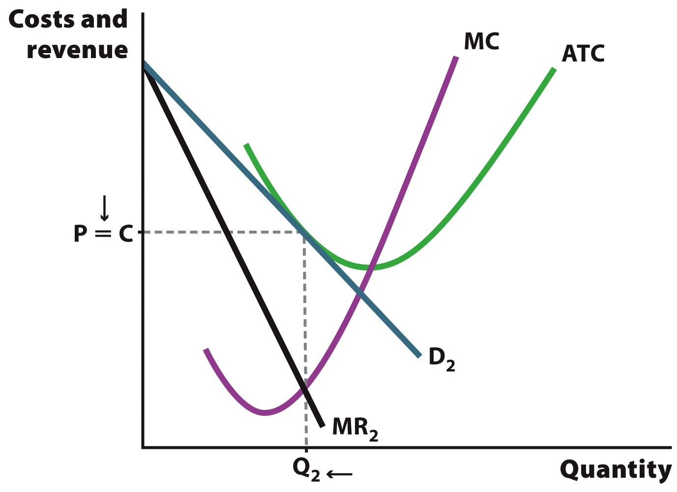
Zero Profit

Slide 27
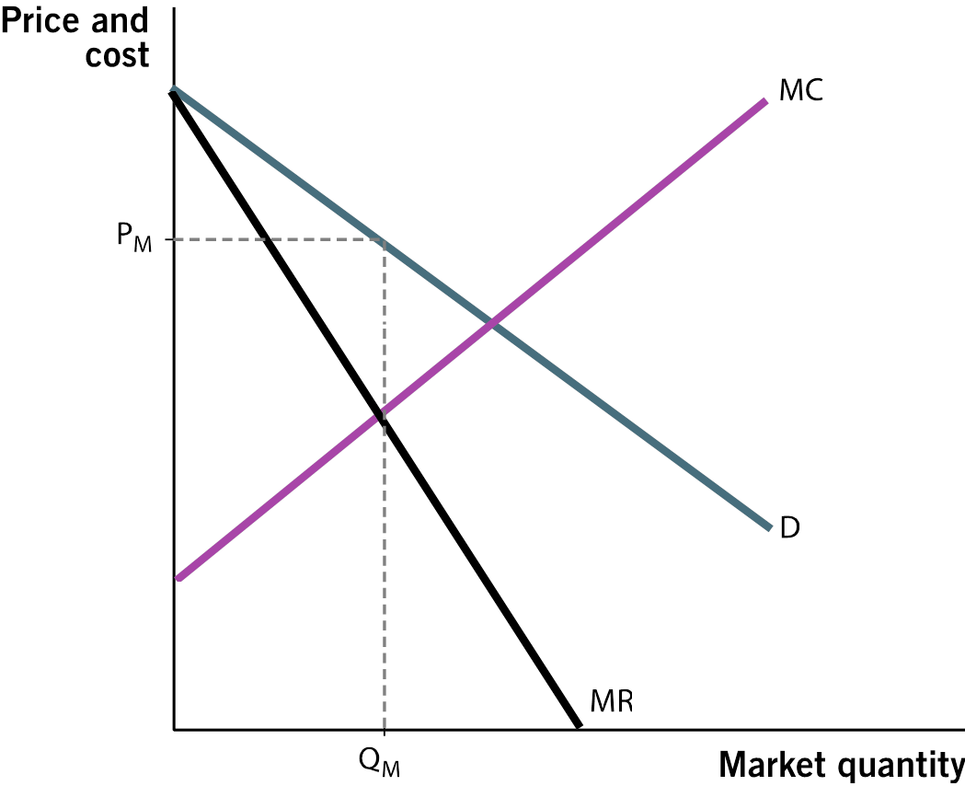
Class Activity: Think-Pair-Share
True or false? A profit-maximizing monopolist will set its price and output where demand is inelastic?
Notes:
Lecture tip:
Ask students to get into pairs and solve the problem on the slide. The answer will be revealed on the next slide.
This is a nice problem that ties together elasticity material with the profit-maximizing solution for a monopolist.
Hint: Remember that a demand curve has three segments where demand is elastic, inelastic, and unit elastic.

Slide 28
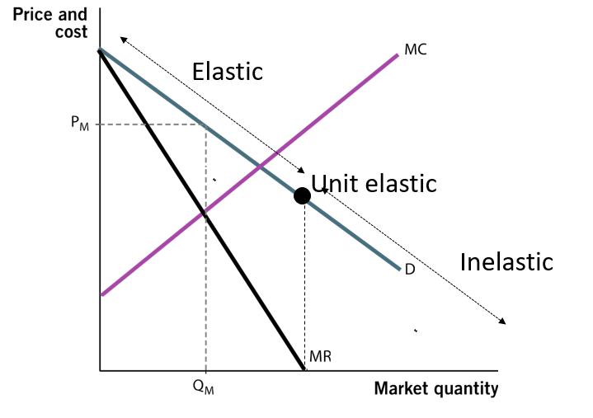
Class Activity: Think-Pair-Share
True or false? A profit-maximizing monopolist will set its price and output where demand is inelastic?
Notes:
Lecture notes:
Start off asking students where total revenue is maximized (where MR = 0).
First click:
Labels point on the demand curve where MR = 0
Then ask them what they know about the elasticity of demand at that point.
Second click:
Labels point "unit elastic"
Then ask them where demand is elastic and inelastic.
Third click:
Labels elastic and inelastic regions of demand curve
So, the answer is False.
A profit-maximizing monopolist will set its profit-maximizing price and output where demand is elastic.

Slide 29
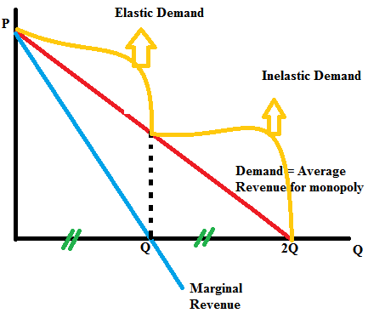
Monopoly Demand, Marginal Revenue, and Elasticity
A monopoly firm will always price its product to ensure that demand is elastic.

Slide 30
Perfectly Competitive vs. Monopoly
Perfectly Competitive | Monopoly
Many firms | One firm
Produces efficient level of output (since P = MC) | Produces less than the efficient level of output (since P > MC)
Cannot earn long-run economic profits | May earn long-run economic profits
Has no market power (is a price taker) | Has significant market power (is a price maker)
Notes:
Really, you can just point out that perfect competition and monopoly are on polar opposite ends of the market structure spectrum.
You may have realized that in real life, we don't often see perfect competition or pure monopoly. Much of our economy lies somewhere between these two extremes. We call this “imperfect competition,” and we can discuss the market structures of oligopoly and monopolistic competition.

Slide 31
Class Activity: Think-Pair-Share
A monopolist faces the following demand and cost schedule. How much should the firm produce? How much profit will it earn? You have five minutes.
Price | Quantity | TR | TC | MR | MC | Profit
$10 | 1 | Empty cell | $2 | Empty Cell | Empty Cell | Empty Cell
$8 | 2 | Empty cell | $4 | Empty Cell | Empty Cell | Empty Cell
$6 | 3 | Empty cell | $6 | Empty Cell | Empty Cell | Empty Cell
$4 | 4 | Empty cell | $8 | Empty Cell | Empty Cell | Empty Cell
$2 | 5 | Empty cell | $10 | Empty Cell | Empty Cell | Empty Cell
Notes:
Lecture tip:
Ask students to get into pairs and solve the problem on the slide. The answers will be revealed on the next slide.

Slide 32
Class Activity: Think-Pair-Share
A monopolist faces the following demand and cost schedule. How much should the firm produce? How much profit will it earn? You have five minutes.
Price | Quantity | TR | TC | MR | MC | Profit
$10 | 1 | $10 | $2 | $10 | $2 | $8
$8 | 2 | $16 | $4 | $6 | $2 | $12
$6 | 3 | $18 | $6 | $2 | $2 | $12
$4 | 4 | $16 | $8 | -$2 | $2 | $8
$2 | 5 | $10 | $10 | -$6 | $2 | $0
Notes:
Lecture notes:
A monopolist should produce where MR = MC = $2.
P = $6, Q = 3, and profit = $12
Be prepared to answer a question such as, "Why isn't P = $8 the answer? After all, the profit is $12 as well."

Slide 33
The Problems with Monopoly
Monopolies can make societies worse off
Restricting output and charging higher prices compared to perfectly competitive markets
Operate inefficiently (deadweight loss). This is referred to as market failure.
Less choices for consumers
Unhealthy competition called "rent seeking"
Notes:
The word “monopoly” often has a negative connotation. With a bad economy, we often hear people complaining about “greedy companies,” “Wall Street,” “banks”, etc.
However, these entities are often not monopolies. Monopolies are often economically inefficient. This comes from the fact that P > MC and that output is restricted compared to competitive markets.

Slide 34
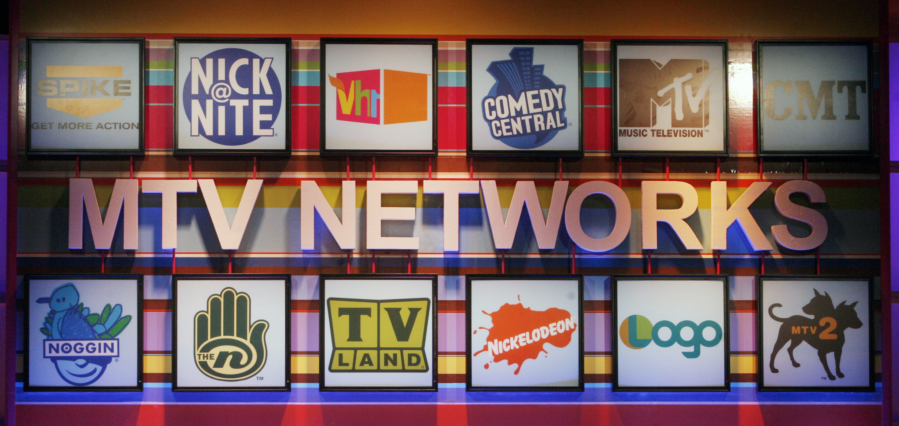
The Problems with Monopoly
Few choices
Restricts consumer ability to put downward pressure on prices. No substitutes.
Cable companies and bundling. Monopolies can force you to buy more.
Rent seeking
Competition among rivals to secure monopoly profits
This type of competition produces one winner without the other usual benefits of competition
Inefficient: Resources used to monopolize rather than become a more competitive firm
Notes:
With fewer choices (no substitutes), consumers may be “forced” to pay higher prices for goods and services since they have no option to buy cheaper substitutes. In addition, multiproduct monopolies (cable companies, for example) may bundle other goods together that you must also buy. This raises prices and profits for the firm and may make consumers buy more goods than they want to.
Rent seeking: think about this as spending time, effort, and resources in ways that attempt to gain monopoly or keep your existing monopoly. Rather than spending money on making a better product or improving production, you spend money on lobbyists and lawyers, and spend resources defending your monopoly. This is an economically inefficient use of resources in this market. The firm is attempting to eliminate competition, but this act doesn't benefit consumers.

Slide 35
Perfectly Competitive vs. Monopoly
Notes:
Left:
Typical firm in a perfectly competitive industry.
Profits for each firm are zero due to free entry of other firms.
(If there ARE profits, other firms will enter and cause the price to fall, decreasing profits.)
Firms are efficient and produce output at the lowest point on their ATC curve.
Right:
A single monopoly firm.
Profits are positive since P > ATC at the level of output chosen.
Output is less than the point at min(ATC), thus the firm is not economically efficient, and there is DWL.
In monopoly, prices are higher and output is lower compared to competitive markets.

Slide 36
Deadweight Loss (DWL) of Monopoly
Part of Consumer Surplus
Transferred to Monopoly
Notes:
The monopolist charges too high a price and produces too little of the product, so some consumers who would benefit from a competitive market lose out. Since the demand curve, or the willingness to pay, is greater than the marginal cost between output levels Q_{M} and Q_{C}, society would be better off if output was expanded to Q_{C}. But a profit-maximizing monopolist will limit output to Q_{M}. The result, a deadweight loss equal to the area of the yellow triangle, is inefficient for society.

Slide 37
Deadweight Loss (DWL) of Monopoly
Part of Consumer Surplus
Transferred to Monopoly
Perfect Competition
Consumer Surplus: A+B+C
Producer Surplus: D+E
Total: A+B+C+D+E
Deadweight loss: 0
B
A
C
E
D
Monopoly
Consumer Surplus: B
Producer Surplus: D+A
Total: A+B+D
Deadweight loss: C+E
Notes:
The monopolist charges too high a price and produces too little of the product, so some consumers who would benefit from a competitive market lose out. Since the demand curve, or the willingness to pay, is greater than the marginal cost between output levels Q_{M} and Q_{C}, society would be better off if output was expanded to Q_{C}. But a profit-maximizing monopolist will limit output to Q_{M}. The result, a deadweight loss equal to the area of the yellow triangle, is inefficient for society.

Slide 38
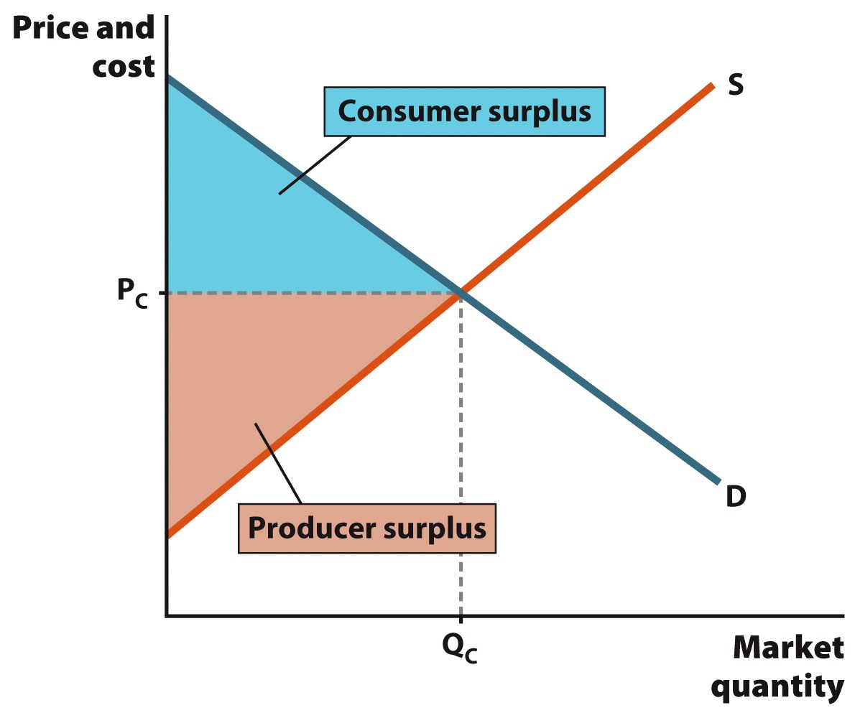
Perfect Competition

Slide 39
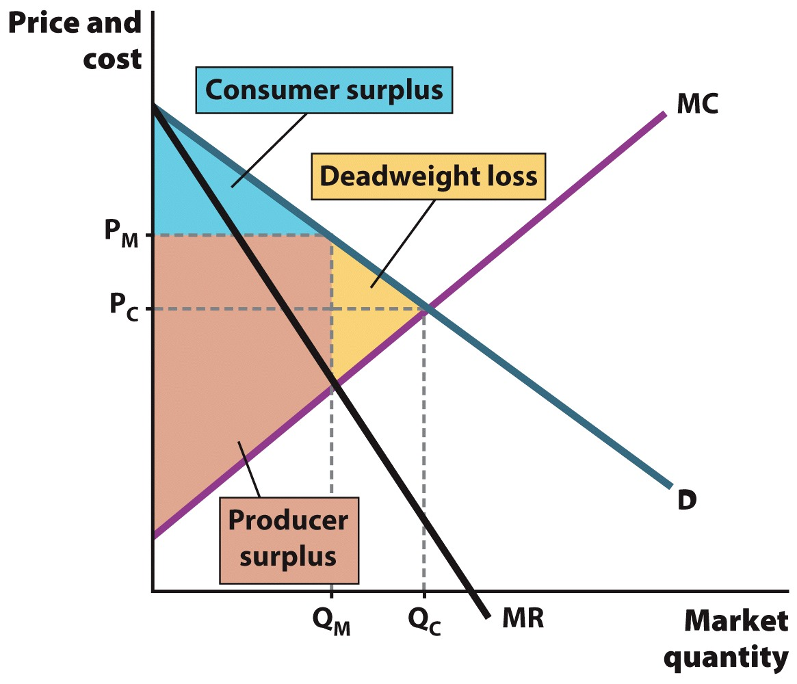
Monopoly

Slide 40
Monopoly versus Competition
Output (quantity)
Q_{Monopoly} < Q_{Competition}
Price
P_{Competition} < P_{Monopoly}
Deadweight loss
Monopoly DWL > 0
Competition DWL = 0
Notes:
In one sentence:
A monopolist produces less output and charges a higher price than competitive markets.

Slide 41
Economics in One-Man Band
"One-Man Band"
Two street musicians compete for the gold coin of a young peasant girl.
The introduction of competition gives producers incentives to work hard and create a better product.
Consumers will have more choices.
Notes:
"Economics in the Media" Slide
Lecture tip:
The clip mentioned on the slide can be found in the Interactive Instructor's Guide. Access the direct link by clicking the icon in the PowerPoint above.
The key concepts covered in this clip are:
Monopoly
Competition
Substitutes

Slide 42
Solution to Monopoly
There are four potential solutions to the problem of monopoly.
First, the government may break up firms to restore a competitive market.
Second, government can promote open markets by reducing trade barriers.
Third, the government can regulate a monopolist's ability to charge excessive prices.
Finally, there are circumstances in which it is better to leave the monopolist alone.
Notes:
The government may want to leave a monopoly alone if the costs of intervention are greater than the benefits of intervention.

Slide 43
Solutions to Monopoly
Harnessing benefits of competition
Splitting up a large company into smaller competing companies
AT&T (1982), Standard Oil (1911)
Sherman Act (1890)
Reduce trade barriers
Allow competitively priced goods to be transported over borders.
This includes state and national borders.
Notes:
1982:
AT&T was split up into eight smaller companies after spending over $300 million defending itself from lawsuits and antitrust legislation.
1911:
Standard Oil controlled 91% of production and 85% of final sales of oil in the United States in 1904. In 1909, the Department of Justice sued the company for violating the Sherman Act. In 1911, the company was forced to break up into 34 independent companies with different boards of directors. The biggest two companies were Exxon and Mobil.
Reducing trade barriers:
Text: The Constitution reads, “No State shall, without the consent of Congress, lay any imposts or duties on imports or exports.” Rarely have so few words been more profound. With this simple law in place, states must compete on equal terms.
In addition, if we eliminate trade quotas and tariffs, international firms may force domestic producers to become more competitive, which will reduce monopoly power.

Slide 44
Solutions to Monopoly
Price regulation
Often, we don't want to break up firms due to large economies of scale.
Don't need to have redundant water pipes, power lines.
In this case, a monopoly may be desirable, but we may still need to regulate the firm to prevent market power abuse.
Notes:
Breakup of a natural monopoly would actually be a bad idea. Due to economies of scale, there are some firms in which bigger really is better. If the ATC curve is downward-sloping over a large range of output, it means that a bigger firm can produce output at a lower cost than many smaller firms.
While this monopoly may be desirable (compared to competition), we still want to make sure that the firm doesn't abuse its monopoly power by charging exorbitantly high prices. This is where price regulation comes in.

Slide 45
Regulatory Solution for Natural Monopoly
Notes:
No regulation:
Unregulated monopolist sets MR = MC and produces Q_{M} at a price of P_{M}. Since P_{M} is greater than the average cost of producing Q_{M} units, or C_{M}, the monopolist earns the profit shown in the green rectangle.
Regulation:
If the firm is regulated, and the price is set at marginal cost, regulators can set P = MC and the output expands to Q_{R.} In this example, since the cost of production is subject to economies of scale, the cost falls from C_{M} to C_{R}. This is a large improvement in efficiency. The regulated price, P_{R}, is lower than the monopolist's price, P_{M}, and production increases. As a result, consumers are better off. But what happens to the monopoly? It loses profits in the amount of the red rectangle. This occurs since the average costs under the marginal-cost pricing solution, C_{R}, are higher than the price charged by regulators, P_{R}.

Slide 46
Marginal Cost Pricing
At P = MC
The monopolist experiences a loss
MC < ATC, so P < ATC (results in losses)
Solutions?
Government subsidies given to the firm.
Set P = ATC at the P = MC output level.
Government ownership of the firm
Notes:
Why is this bad?
Subsidies come from the government, which taxes YOU! So you now have lower prices, but now have to pay higher taxes to subsidize the firm!
Government ownership creates many more problems, which we will see next.

Slide 47
Government Failure
Government intervention
Can eliminate the profit motive and the necessity to innovate and improve efficiency.
Government employees are rarely fired, regardless of performance.
Free market
Firms under MC pricing have no incentive to lower costs.
Often better than government intervention and changing incentives for a firm
Notes:
Lecture notes:
It all comes down to incentives. The government can always “bail itself out,” so it has no incentive to be efficient, keep costs down, or fire bad employees. A private firm has to take care of its own expenses and has the incentive to find and eliminate inefficiencies.

Slide 48
Economics in Seinfeld
"Seinfeld"
"Soup Nazi" (1995)
If a monopoly's product is extremely popular, people will do just about anything to get the product since there is no substitute.
What happens to monopoly power if a substitute product can be introduced?
Notes:
Economics in the media
Lecture tip:
The clip mentioned on the slide can be found in the Interactive Instructor's Guide. Access the direct link by clicking the icon in the PowerPoint above.

Slide 49
Conclusion
While competitive markets generally bring about welfare-enhancing outcomes for society, monopolies often do the opposite.
Government seeks to limit monopoly outcomes and promote competitive markets.
Perfectly competitive markets and monopoly are market structures at opposite extremes.
Most economic activity takes place between these two alternatives.
Notes:
You can think that we often talk about perfect competition (PC) and pure monopoly in the theoretical sense because they are very rare (by strict definition and assumptions) in real life. Many firms have some competitive characteristics and some monopolistic characteristics. This will be studied in the upcoming chapters.

Slide 50
Summary
Monopolies
Market structure characterized by a single seller who produces a well-defined product with few good substitutes
Operate in a market with high barriers to entry, the chief source of market power.
May earn long-run profits
Perfectly competitive firms are price takers. Monopolists are price makers.

Slide 51
Summary
Like perfectly competitive firms, a monopoly tries to maximize its profits.
Same profit maximizing rule of MR = MC is used.
From an efficiency standpoint, the monopolist charges too much and produces too little.
Since the output of the monopolist is smaller than would exist in a perfectly competitive market, the outcome also results in deadweight loss.

Slide 52
Practice What You Know
Which of the following firms will most likely be a natural monopoly?
A grocery store
A cable TV company
A gas station
A barbershop
Notes:
Correct answer: B
Town utilities (cable, gas, electricity, water) usually are natural monopolies due to their cost structure.

Slide 53
Practice What You Know
What is true for a profit-maximizing monopoly?
P = MR = MC
P = MR > MC
P > MR = MC
P > MR > MC
Notes:
Correct answer: C
Any firm wants to sell output where MR = MC.
However, in monopoly, P > MR.
In competition, we have P = MR = MC.

Slide 54
Practice What You Know
What is the reason for monopoly deadweight loss (relative to perfect competition)?
The monopolist faces a downward sloping demand curve
People boycott monopolies more often
The monopolist sells less output at a higher price
The monopolist has no competitors
Notes:
Correct answer: C
With monopoly, we don't maximize gains from trade by reaching the same equilibrium that a perfectly competitive market reaches.

Slide 55
Practice What You Know
A monopolist will have negative profits and exit the industry in the long-run if:
A new competitor enters the industry
Demand becomes more elastic
Price < ATC
A monopolist never has negative profits
Notes:
Correct answer: C
A monopolist can still earn negative profits. Maybe demand for the product is low, or the firm's costs are too high.

Slide 56
Sources
"Principles of Economics with Smartwork Access (ISBN: 978-0-26314-5), 1st Edition, 2013" by Mateer and Coppock
"Economics: Custom Edition for NCSU (ISBN: 9781937435202" by David Hyman

